Slide 1
Arduino Line Follower Robot

Slide 2
Introduction
A Line Follower Robot, as the name suggests, is an automated guided vehicle, which follow a visual line embedded on the floor or ceiling. Usually, the visual line is the path in which the line follower robot goes and it will be a black line on a white surface but the other way (white line on a black surface) is also possible. Certain advanced Line Follower Robots use invisible magnetic field as their paths.
Large line follower robots are usually used in industries for assisting the automated production process. They are also used in military applications, human assistance purpose, delivery services etc.
Large line follower robots are usually used in industries for assisting the automated production process. They are also used in military applications, human assistance purpose, delivery services etc.

Slide 3
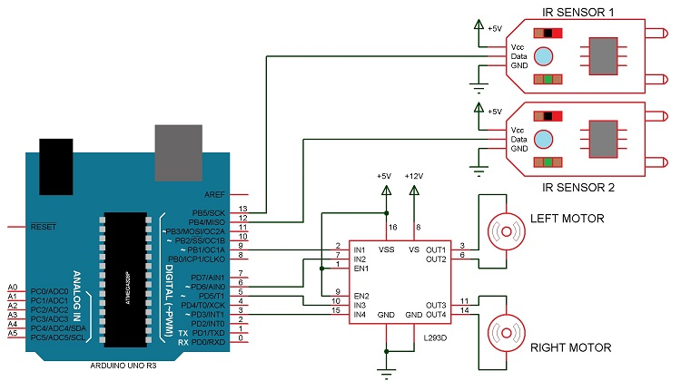
Circuit Diagram
1

Slide 4
Components Required
Arduino UNO (or Arduino Nano)
L293D Motor Driver IC
Geared Motors x 2
Robot Chassis
IR Sensor Module x 2
Black Tape (Electrical Insulation Tape)
Connecting Wires
Power supply

Slide 5
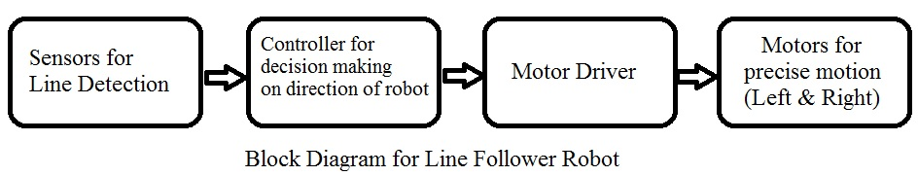
Block Diagram of the Project
The line follower robot built in this project is divided in to 4 blocks. The following image shows the block diagram for line follower robot.

Slide 6
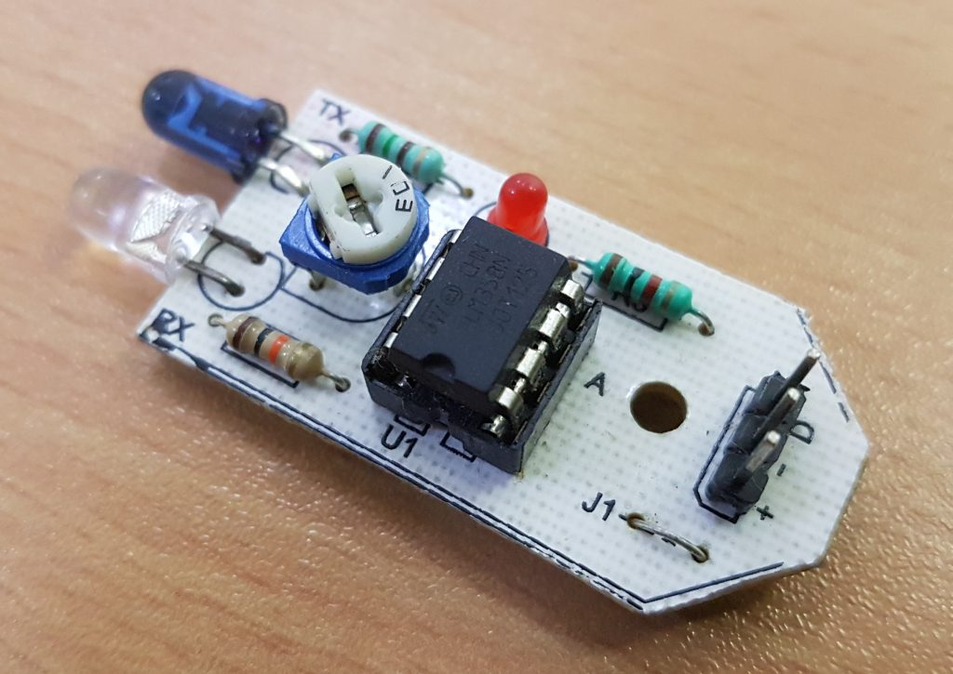
Block Diagram Description
Sensors (IR Sensor):
We have used IR Sensor Module as the line detecting sensor for the project. It
consists of an IR LED and a Photo diode and some other components like comparator, LED etc.

Slide 7
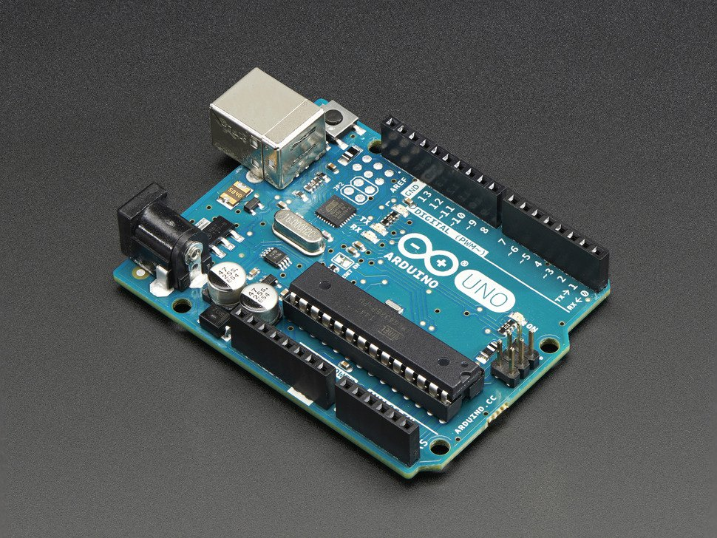
Controller (Arduino UNO):
Arduino UNO is the main controller in the project. The data from the sensors (IR Sensors) will be given to Arduino and it gives corresponding signals to the Motor Driver IC.

Slide 8
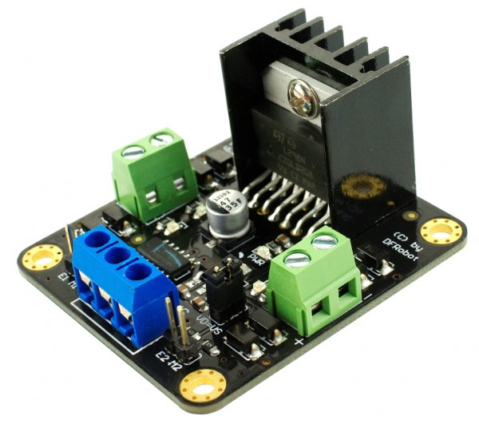
Motor Driver (L293D):
L293D Motor Driver IC is used in this project to drive the motors of the robot. It receives signals from Arduino based on the information from the IR Sensors.

Slide 9
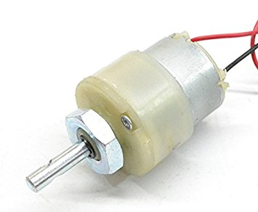
Motors (Geared Motors):
We have used two geared motors at the rear of the line follower robot. These motors provide more torque than normal motors and can be used for carrying some load as well.

Slide 10
Thanks!

